Slide 1
Hey!
Greetings from Team Space Cake!

Slide 2
Our Team Vision!
We aim to strive and work towards newer technologies like Hybrid Mobile Development platform (such as Flutter) , and explore the unknown and underrated platform for it’s implementation.
We fail , a lot , but we learn with these experience to bring out apps on peculiar ( almost ignored ) platforms to create awareness about how awesome newer technologies such as hybrid mobile development could be !..
Our team is as cohesive as a brotherhood , were we dare to step into the unknown , the underrated and the ignored and bring out something awesome out of it!

Slide 3
What we made
Our application is the world’s first deployment of an idea based on network radio where we provide independent radio stations for a smartwatch running Wear OS. This allows the user to consume music content without the dependency of any other external device ( Other than the fact that they need to connect an audio system with the Wear OS device, assuming it doesn’t have a speaker ). We aim to exhibit the deployment of Flutter SDK across underrated platforms and build independent apps for portable environments such as Wear OS.

Slide 4
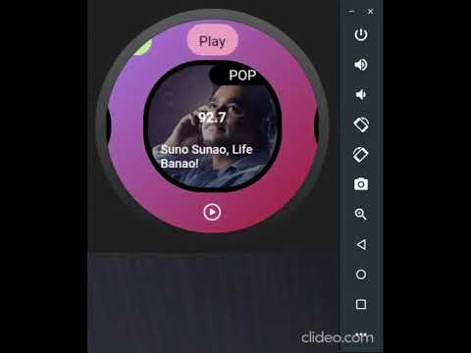
Working

Slide 5
While Flutter is officially supported on iOS and Android phones, it happily runs on other Android platforms, such as Android for Chrome OS and Wear OS. Flutter isn’t optimized for these devices of devices, but we believe it is possible with the release of flutter 2.0.
Wear OS by Google, formally known as Android Wear 2, is essentially full-stack Android, with a set of libraries for watch-specific functionality and form factors. Wear 1.0 forbade making network connections directly from the device, requiring all data to flow through companion apps on the paired phone. Wear OS removed that restriction, and it’s now possible to write standalone apps on these devices.
While that’s fine, writing Wear apps require developers to pay attention to the watch's specifics: does it have a square or a round watch face, and what are its dimensions; what should the app display when the watch enters ambient mode? How can Flutter access the Wear APIs, and what patterns can be used to expose said functionality in an elegant, Flutter-like way? For long-running Wear apps, supporting ambient mode is critical. Natively holding a wake lock keeps the screen at full brightness and kills battery life.
Flutter provides a mechanism to bidirectionally call between Dart and native platform code, using “MethodChannels.” Functions in either realm can be asynchronously called, and simple data types passed back in response. Data can also be streamed using “EventChannels.”
While Flutter isn’t optimized for Wear devices, experimenting on Wear is possible. Flutter’s widget pattern provides an elegant means of handling Wear-specific functionality that lends itself to writing simple, understandable code.

Slide 6
Goals
To set an example of hybrid mobile development on a platform, as small as a smartwatch.
Our main objective for this tech deployment is to create a customizable and accessible standalone internet radio access for all Wear OS users, making it independent of a 2nd party device like an Android Phone.
To display the flexibility & expanded features of using hybrid application development platforms such as Flutter SDK on platforms such as Android Auto, Wear OS, etc.

Slide 7
Challenges we ran into
Compatibility issues with wear OS as all manufacturers provide different specifications OS making it compatible with almost every Wear OS was a challenge.
FM Radio using the internet was an issue in Wear OS.
While Flutter isn’t optimized for Wear devices, experimenting on Wear is possible. Flutter’s widget pattern provides an elegant means of handling Wear-specific functionality that lends itself to writing simple, understandable code.
writing Wear apps require developers to pay attention to the watch's specifics: does it have a square or a round watch face, and what are its dimensions; what should the app display when the watch enters ambient mode? How can Flutter access the Wear APIs, and what patterns can be used to expose said functionality in an elegant, Flutter-like way? For long-running Wear apps, supporting ambient mode is critical. Natively holding a wake lock keeps the screen at full brightness and kills battery life.

Slide 8
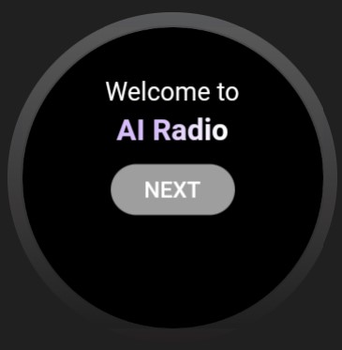
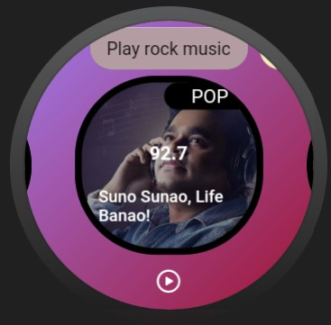
Demo

Slide 9
What we learned!
> We learned to deploy wireframe designs using tools like figma and XD in a hybrid development environment such as Flutter.
> We finally understood how to deploy Flutter on WearOS! ( This one was pretty hectic )
> While Flutter isn’t optimized for Wear devices, experimenting on Wear is possible. Flutter’s widget pattern provides an elegant means of handling Wear-specific functionality that lends itself to writing simple, understandable code.

Slide 10
THANK YOU!

